Slide 1

Lecture 14
MFML Team

Slide 2
Agenda
Mathematical preliminaries for Support Vector Machines
Constrained optimization and Lagrange multipliers.
Primal and dual problems and how their solutions are related, strong duality
Karash-Kuhn-Tucker conditions.
Introduction to classification Problem
Setting SVM Primal problem
Deriving solution of SVM primal problem using duality(If time permits)

Slide 3
Optimization problem
We shall work with the following optimization problem:
min f (x) subject to
g_{i} (x) ≤ 0 ∀i ∈ [m]
h_{j} (x) = 0 ∀j ∈ [p]

Slide 4
Optimization problem : Lagrangian
The Lagrangian associated with this optimization problem is
i =m j=p
minf (x) + λ g (x) + ν h (x)
Σ Σ
i j j
i =1 j=1
The λ_{i} s and ν_{j}s are called Lagrange multipliers.

Slide 5
Quadratic programming
Consider the following primal problem:
We now consider the case of a quadratic objective function subject to linear constraints:
1
min x ^{T} Qx + c ^{T} x
x∈R^{d} 2
subject to Ax ≤ b
Here A ∈ R^{m×d} , b ∈ R^{m}, c ∈ R^{d}

Slide 6
Quadratic programming
The Lagrangian L(x , λ) is given by
¹ x ^{T} Qx + c ^{T} x + λ^{T} (Ax − b).
2
Rearranging the above we have
L(x , λ) = ¹ x ^{T} Qx + (c + A^{T} λ)^{T} x − λ^{T} b
2
Taking the derivative of L(x , λ) and setting it equal to zero gives Qx + (c + A^{T} λ) = 0.

Slide 7
Quadratic programming
We will now derive the dual problem
If we take Q to be invertible, we have x = -Q⁻¹(c + A^{T} λ).
Plugging this value of x into L(x , λ) gives us
D(λ) = − ¹ (c + A^{T} λ)Q⁻¹(c + A^{T} λ) − λ^{T} b.
2
This gives us the dual optimization problem:
max
1 T −1 T T
λ∈R
m − (c + A λ)Q (c + A λ) − λ b subject to
2
λ ≥ 0.

Slide 8
Summary
The original problem is :
1
min x ^{T} Qx + c ^{T} x
x ∈R^{d} 2
subject to Ax ≤ b
The dual problem is
max − ¹ (c + A^{T} λ)Q⁻¹(c + A^{T} λ) − λ^{T} b
λ≥0 2

Slide 9
Weak duality
Weak duality establishes an inequality connecting primal and dual problems
Weak duality condition states that the optimal solution of the primal problem is greater than or equal to that of the dual problem.
In the Quadratic Optimization problem discussed previously , weak duality exists

Slide 10
Strong duality
Strong duality condition states that the optimal solution of the primal problem is equal to that of the dual problem
One can solve the dual problem to get the same solution as solving the primal problem.
In some optimization problems, solving the dual problem may be easier.
Question: When does strong duality hold?

Slide 11
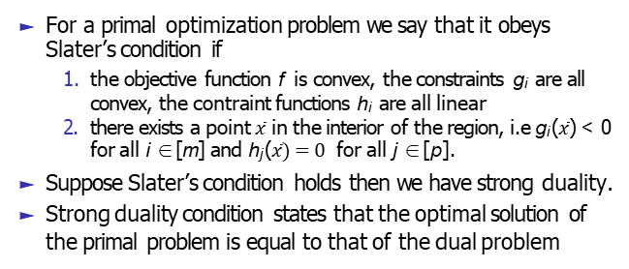
Slater’s condition
For a primal optimization problem we say that it obeys Slater’s condition if
the objective function f is convex, the constraints g_{i} are all convex, the contraint functions h_{i} are all linear
there exists a point $\overline{x}$ in the interior of the region, i.e g_{i} ($\overline{x}$) < 0 for all i ∈ [m] and h_{j} ($\overline{x})=0$ for all j ∈ [p].
Suppose Slater’s condition holds then we have strong duality.
Strong duality condition states that the optimal solution of the primal problem is equal to that of the dual problem

Slide 12
Example of Slater’s condition
We will consider an optimization problem as given below. Let us check whether the strong duality holds for this optimization problem
min x ² + y ²
st x + y − 3 ≤ 0
Here f (x, y ) = x ² + y ² is a convex function and
g (x, y ) = x + y − 3 is a convex function
We can find a point that satisfies the condition x + y − 3 < 0
Slaters condition is satisfied
Hence Strong duality holds for this optimization problem

Slide 13
KKT conditions
min f (x) sub to g_{i} (x) ≤ 0 ∀i ∈ [m], h_{j} (x) = 0 ∀j ∈ [p] We say that x∗ and (λ∗, ν∗) ∈ R^{m} × R^{p} respect the
Karash-Kuhn-Tucker conditions if:
1. g_{i} (x∗) ≤ 0 ∀i ∈ [m], h_{i} (x∗) = 0 ∀i ∈ [p].
2. λ∗ ≥ 0 ∀i ∈ [m].
i
3. λ∗g_{i} (x∗) = 0 ∀i ∈ [m].
i
∗
i =m
∗ ∗
i =p
∗ ∗
4. ∇f (x ) +
λ ∇g (x ) +
ν ∇h (x ) = 0.
Σ Σ
i i
i =1 i i =1 i
If strong duality holds then any primal optimal solution x∗ and dual optimal solution (λ∗, ν∗) satisfy the KKT conditions.

Slide 14
KKT condition
We will consider the same previous optimization problem and will write its KKT conditions.
min x ² + y ²
st x + y − 3 ≤ 0
Here f (x, y ) = x ² + y ² and g (x, y ) = x + y − 3
x + y − 3 ≤ 0
λ ≥ 0
λ(x + y − 3) = 0
∇f + λ∇g = 0
Think: What are the values x, y and λ that satisfy conditions 1, 2, 3, and 4.
Write the KKT condition for the same optimization problem where the constraint have equality instead of inequality.

Slide 15
Classification Problem in Machine Learning
Classification of data into different classes is one of the primary problems in machine learning
Binary classification involves classifying data into exactly 2 classes
There are different algorithms for binary classification
We will discuss a model called Support Vector Machine.
SVM is a linear classifer model for binary classification

Slide 16
Linearly Sparable Data
We always assume that the given data is linearly separable data.
Linear separability refers to the ability to separate data points of different classes using a linear decision boundary, such as a line in two dimensions or a hyperplane in higher dimensions. If such a boundary exists, the data is said to be linearly separable.

Slide 17
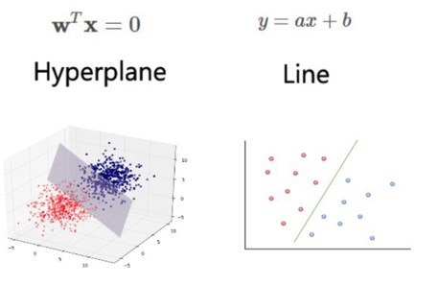
Linear Classifier

Slide 18
Linear Classifier and Hyperplane
Consider line w ^{T} x + b = 0. Let x_{a} and x_{b} lie on this line. So
w ^{T} x_{a} + b = 0 and w ^{T} x_{b} + b = 0.
This means w ^{T} (x_{a} − x_{b} ) = 0. x_{a} − x_{b} lies on the line and is directed from x_{b} to x_{a}.
Hence w is orthogonal to x_{a} − x_{b} and in turn, to the line.

Slide 19
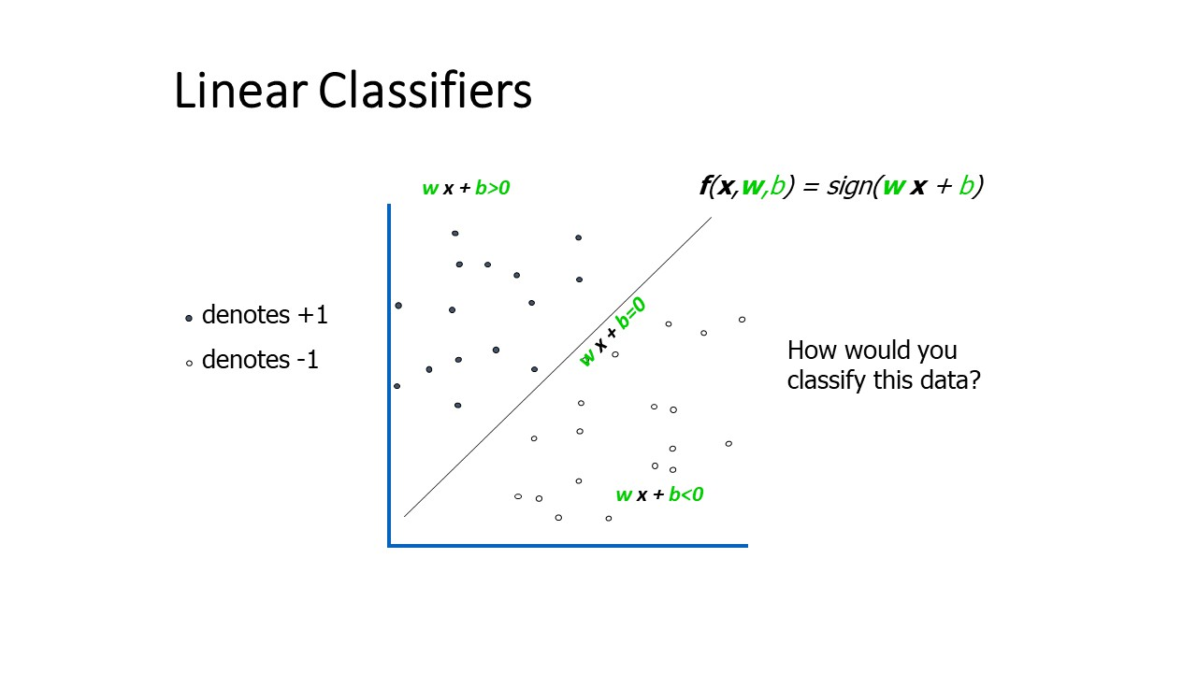
Linear Classifer for Binary Classification

Slide 20
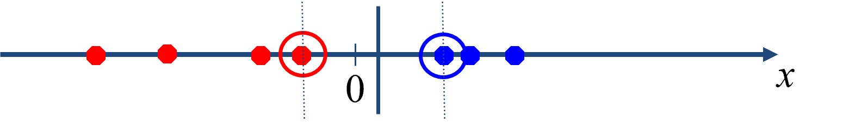
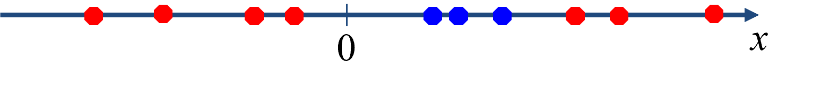
Two examples of data
Dataset that are linearly separable with some noise
Dataset is not linearly separable

Slide 21
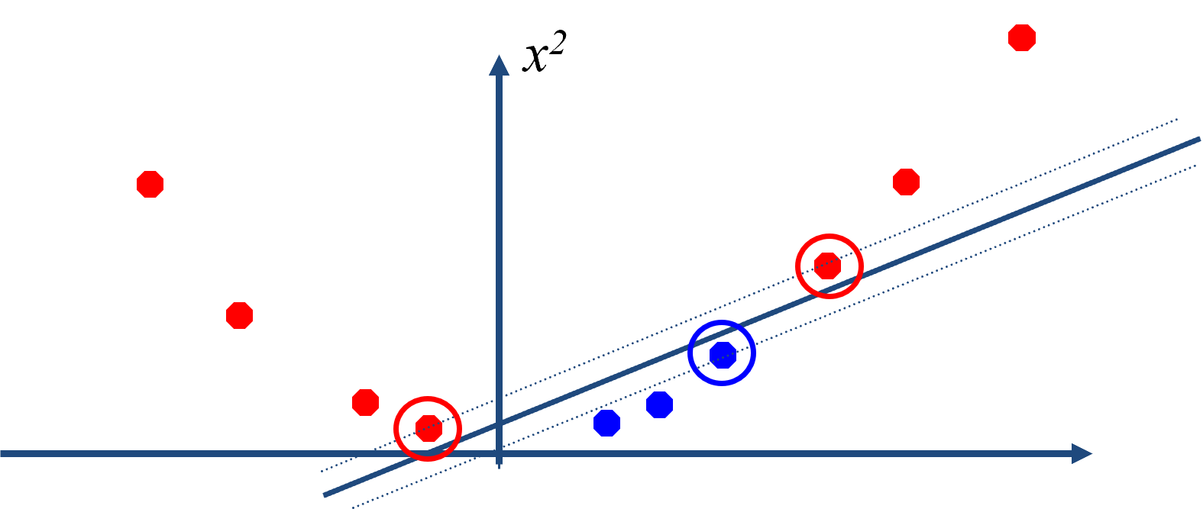
Mapping of Data
mapping data to a higher-dimensional space:

Slide 22
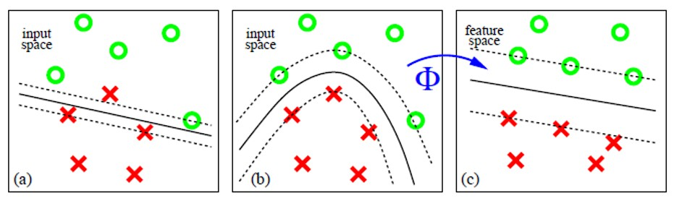

Mapping of Data
Find a feature space
If every data point is mapped into high-dimensional space via some transformation ϕ : x → ϕ(x )

Slide 23
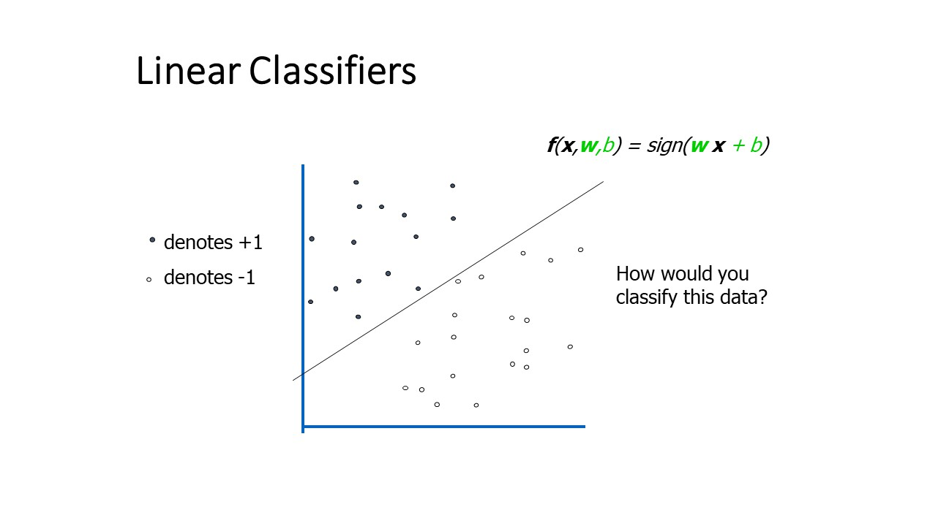
Linear Classifiers

Slide 24
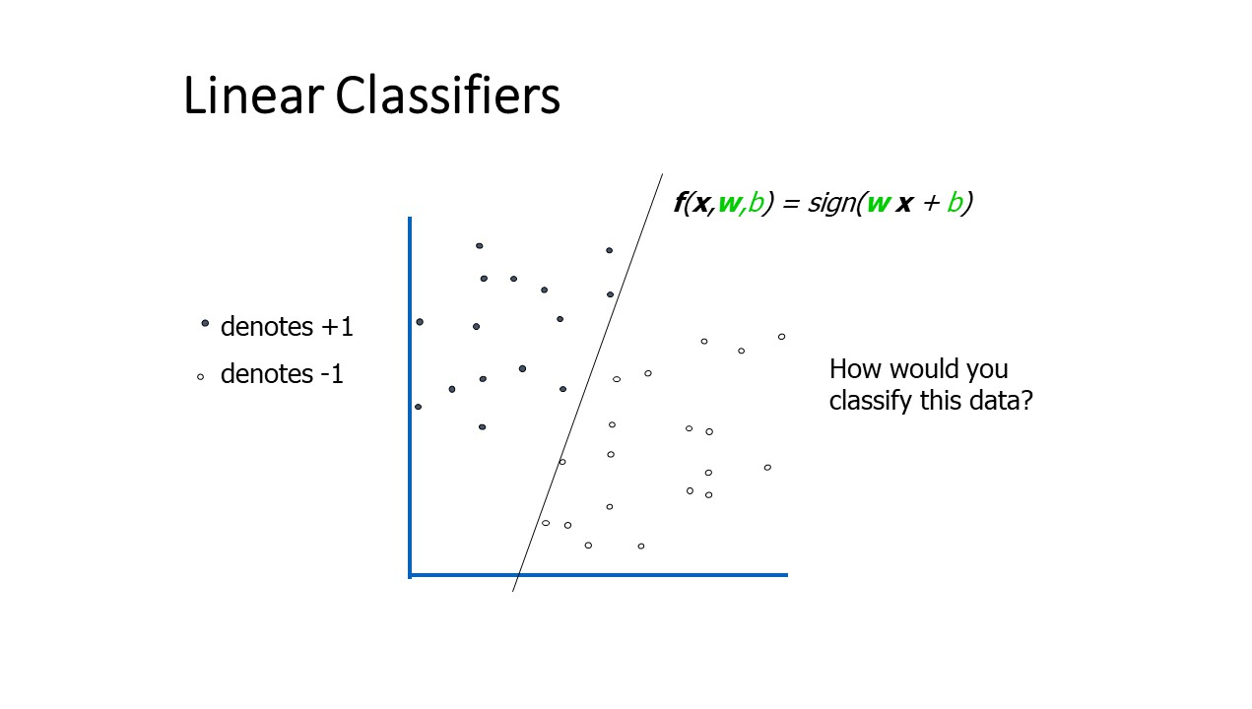
Linear Classifier

Slide 25
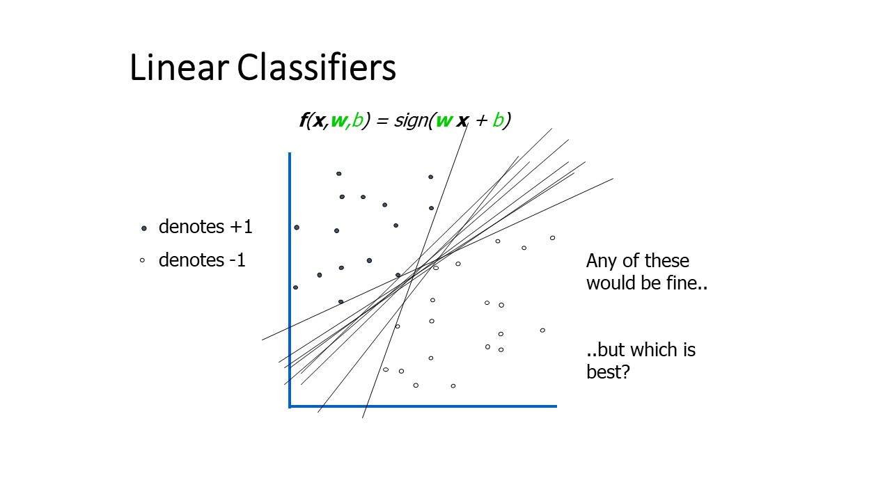
Linear Classifier

Slide 26
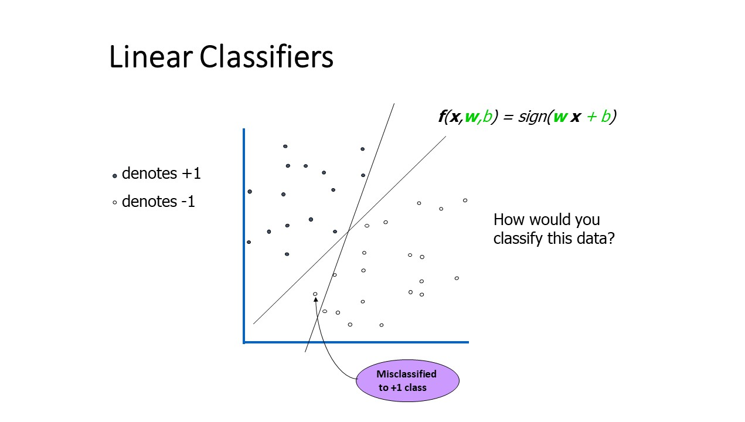
Linear Classifier

Slide 27
Definition of Margin
For a dataset {(x₁, y₁), · · · , (x_{n}, y_{n})} that is linearly separable, there are infintely many hyperplanes.
To find a unique solution, choose the separating hyperplane that maximizes the margin between the positive and negative examples.
Margin is the distance of the separating hyperplane to the closest example x_{a} in the dataset that is linearly separable.

Slide 28
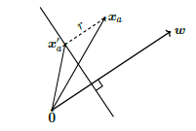
Setting Primal SVM Problem
WLOG let x_{a} be on the positive side of the hyperplane, r be the distance of x_{a} from hyperplane and x_{a}‘ be the orthogonal projection of x_{a} onto the hyperplane. Using the fact that both w and x_{a} – x_{a}’ are orthogonal to the hyper plane we get,
w w
x − x′ = r
a
a
⇒ y_{n}(⟨w, x_{n}⟩ + b) ≥ r
We can assume w = 1 as our interest is in the direction of w

Slide 29
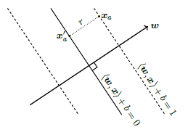
Setting Primal SVM Problem
Together, we get
max r
w,b,r
subject to y_{n}(⟨w, x_{n}⟩ + b) ≥ r , w = 1, r > 0.
In the following theorem (next slide) we will see that we can rescale the data such that the closest example is of distance1to the hyperplane.
We state here without proof.
For the proof refer the text book pno 378.

Slide 30
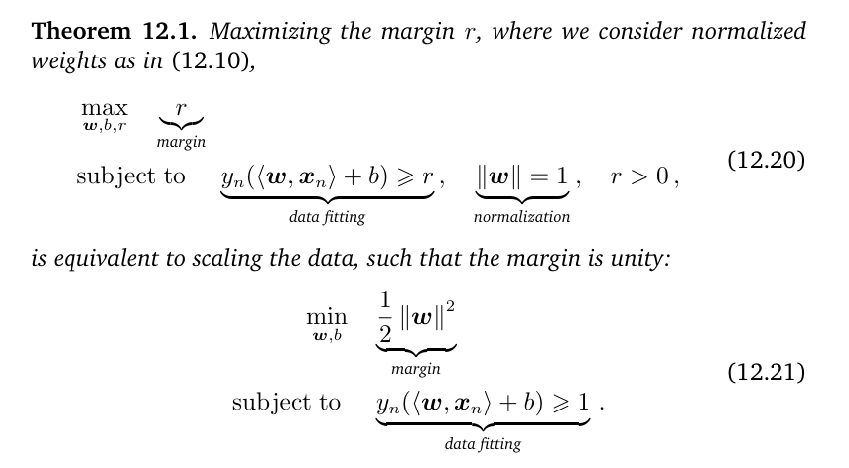

Slide 31
How max r is turned into min ½ ||w||²
As, x_{a}‘ is the orthogonal projection of x_{a} on the hyperplane ,
w
w w
1
w
⟨w, x_{a} − r ⟩ + b = 0, as x_{a}‘ = x_{a} − r
⇒ r =
w
1
Thus max
w,b w
subject to y_{n}(⟨w, x_{n}⟩ + b) ≥ 1, ∀n = 1, · · · N
It can be written as, where no violations of margins are allowed,
1 ₂
min w (hard margin SVM)
w,b 2
subject to y_{n}(⟨w, x_{n}⟩ + b) ≥ 1, ∀n = 1, · · · N

Slide 32
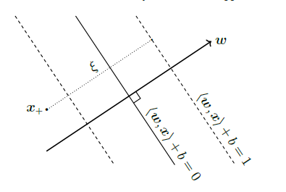
Soft Margin SVM
When data is not linearly separable, we maywish to allow some points to fall within the region or even to be on the wrong side of hyperplane.
The model that allows some classifications errors is called the soft margin SVM.

Slide 33

The key geometric idea is to introduce a slack variable ξ_{n} corresponding to each example - lable pair (x_{n}, y_{n}) that allows a particular example to be within the margin or even on the wrong side of the hyperplane.
N
1
min w + C ξ
Σ
w,b 2
n
n=1
subject to y_{n}(⟨w, x_{n}⟩ + b) ≥ 1 − ξ_{n} ξ_{n} ≥ 0, n = 1, · · · , N

Slide 34
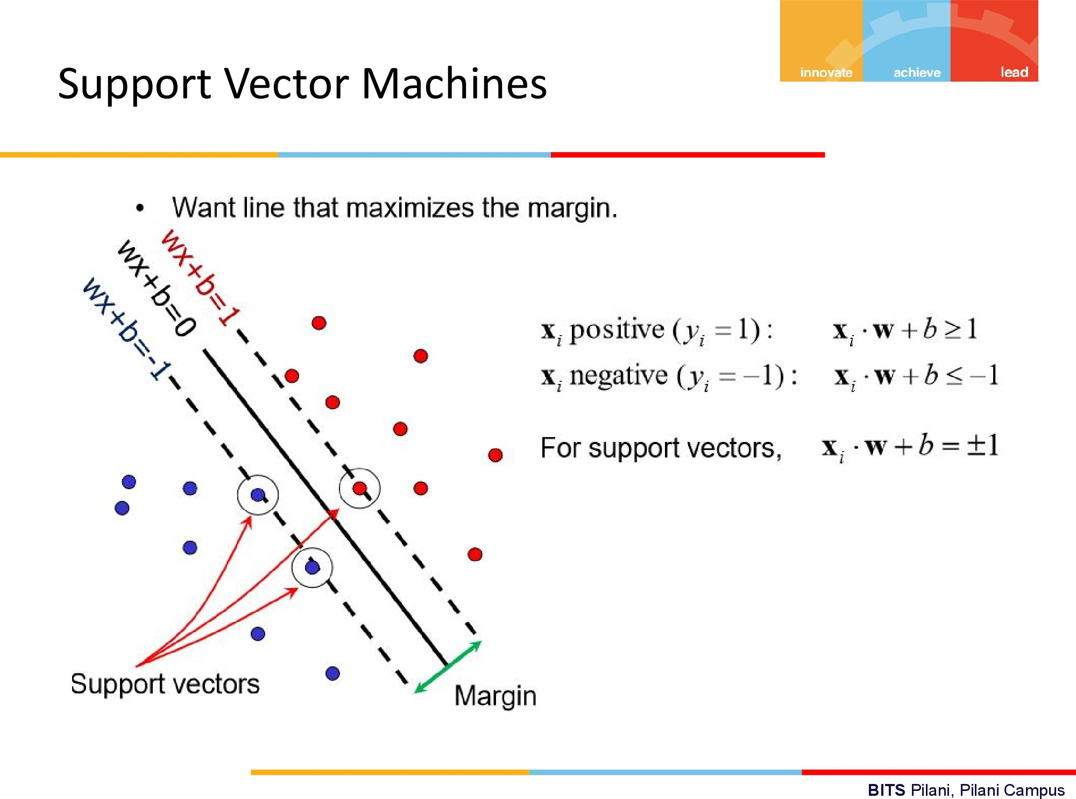

Slide 35
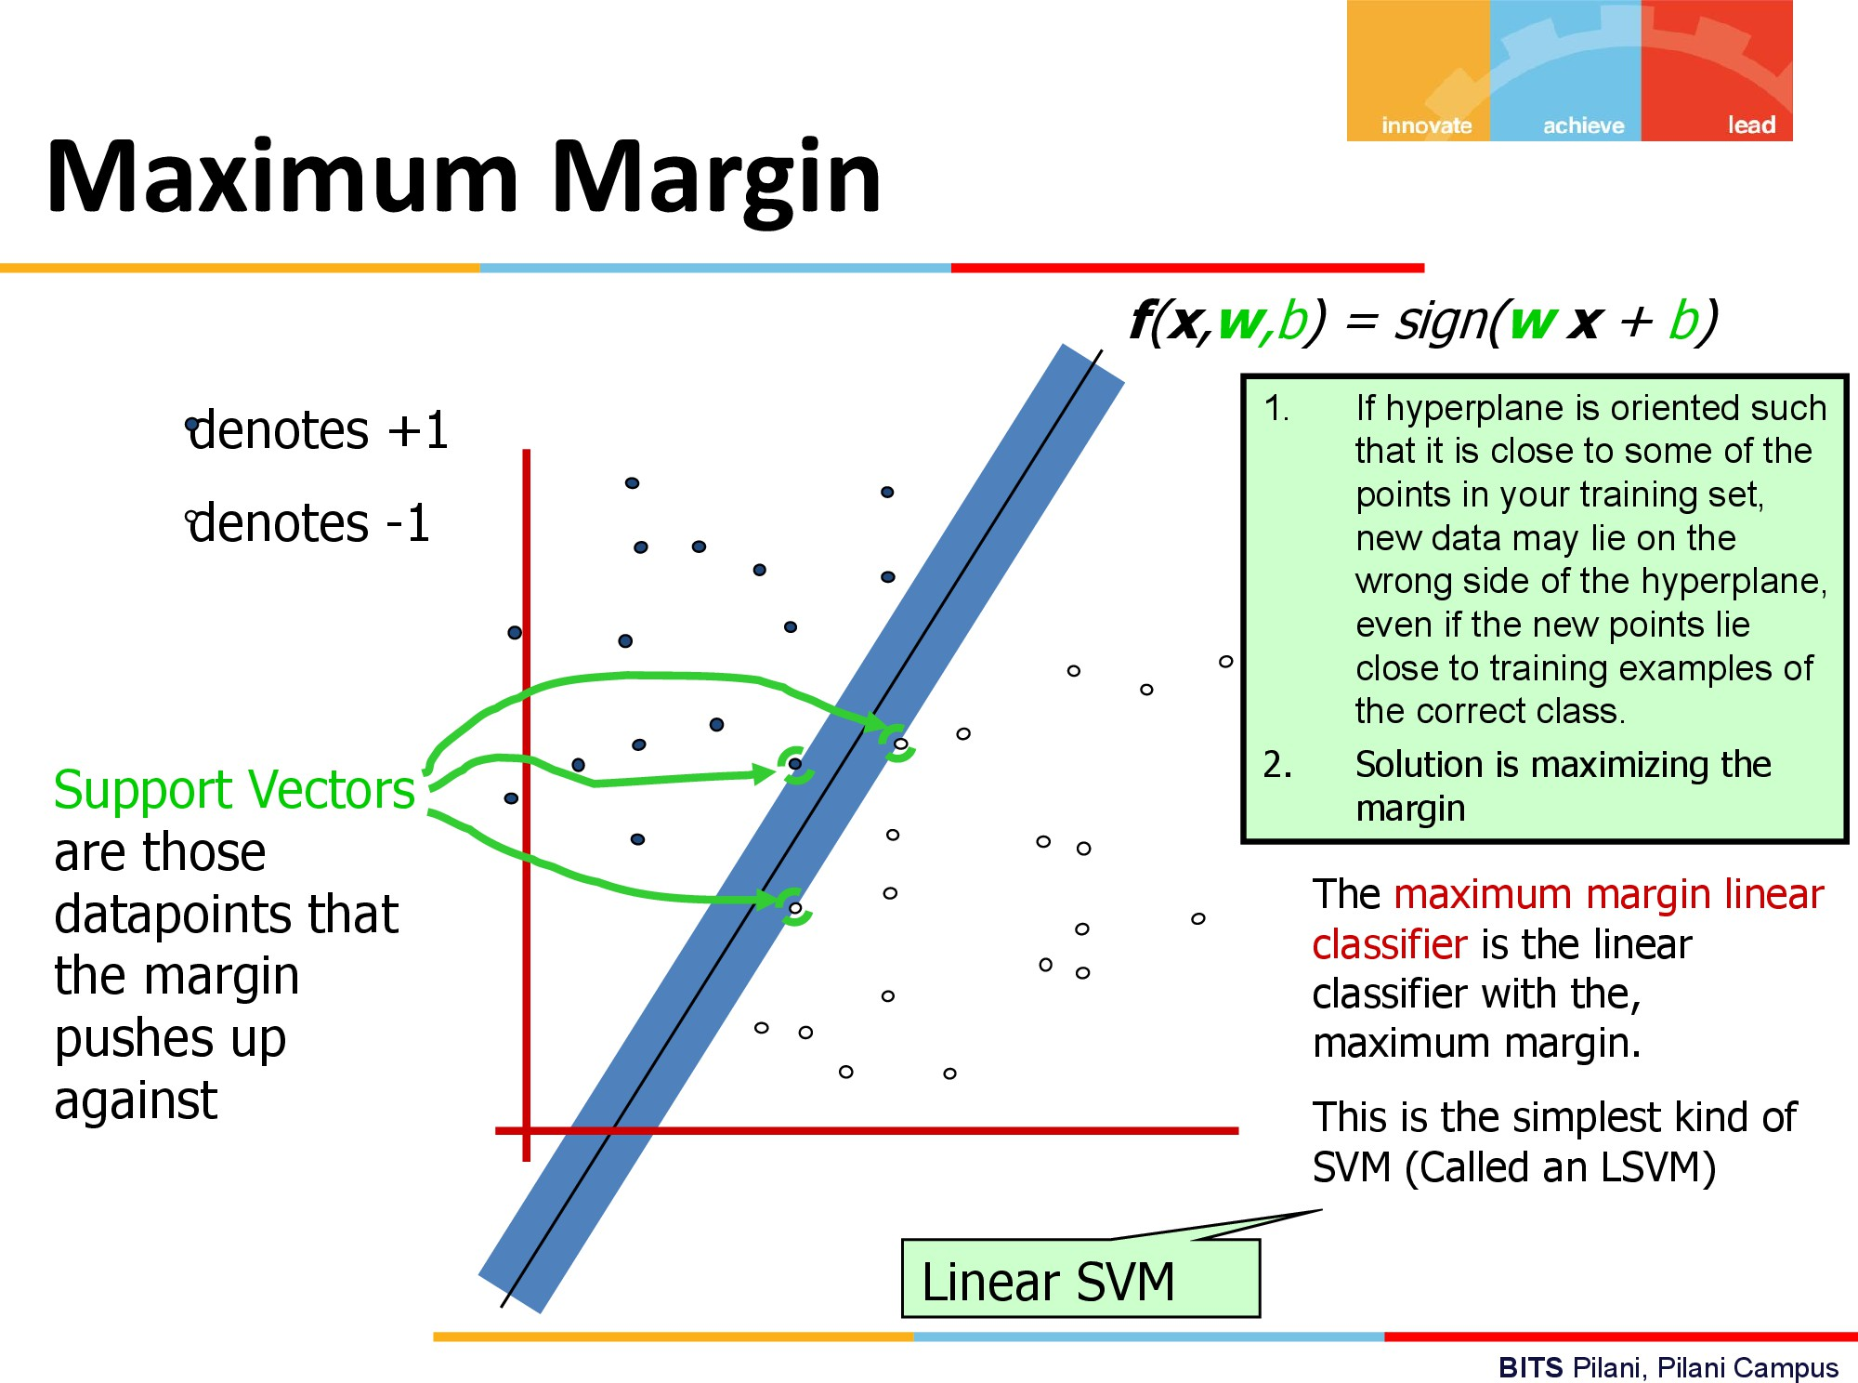

Slide 36
Now let us attention to how we solve the SVM primal problem?

Slide 37
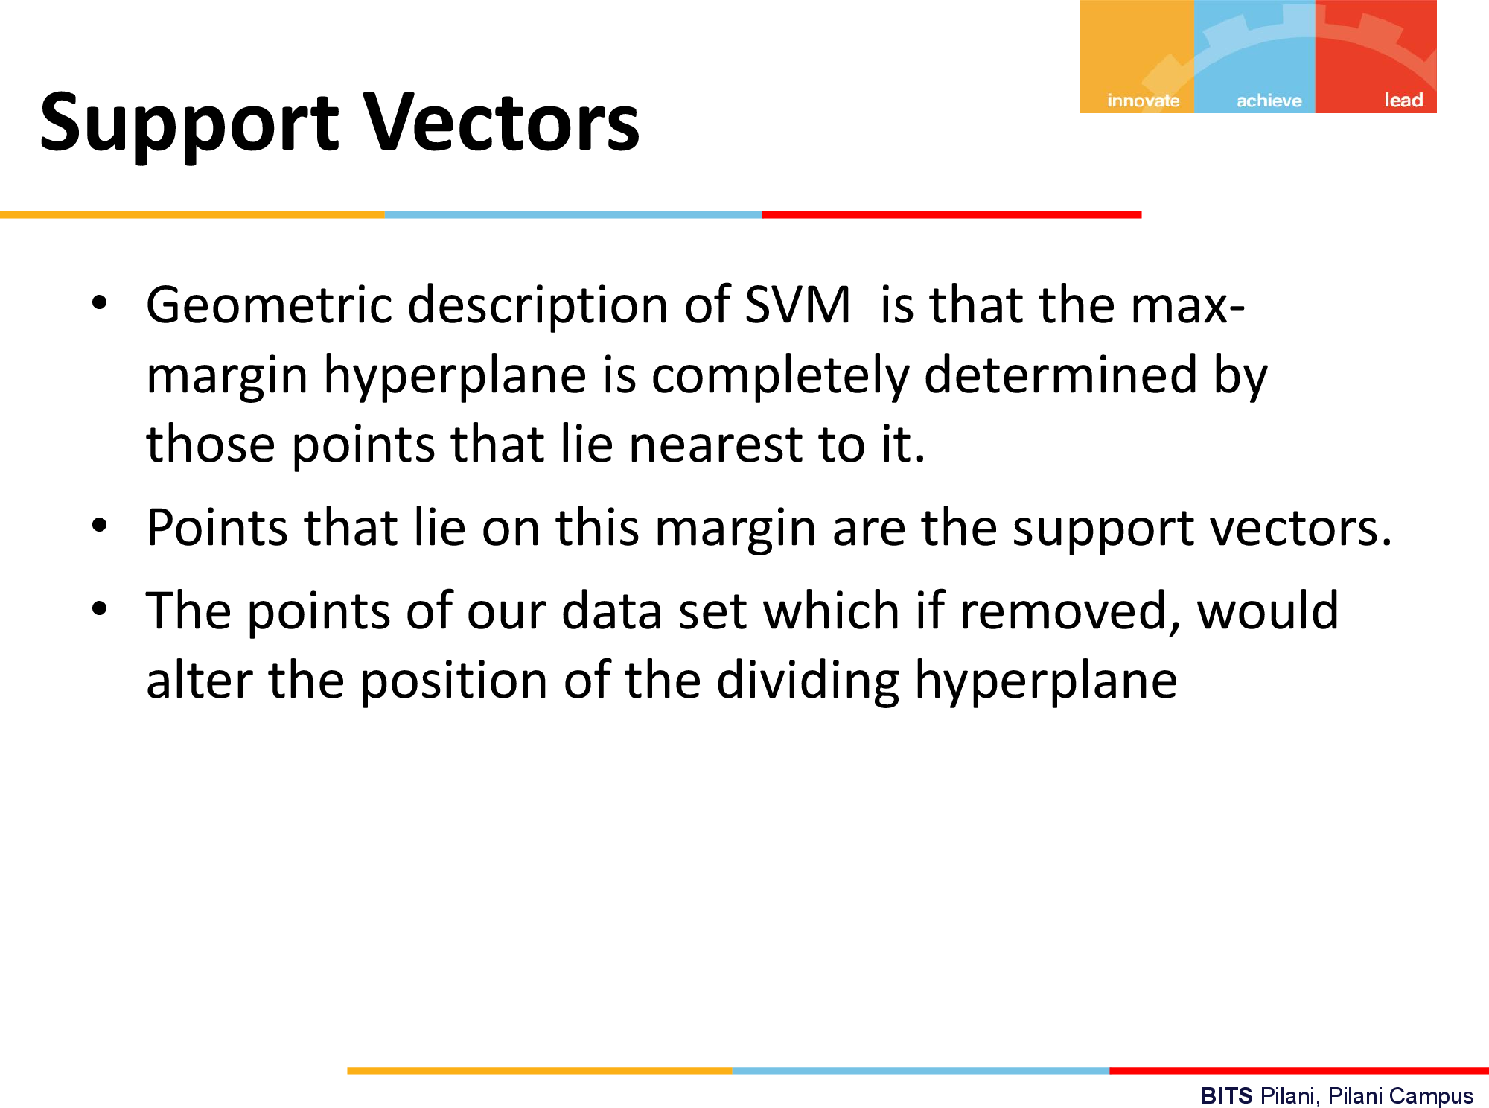
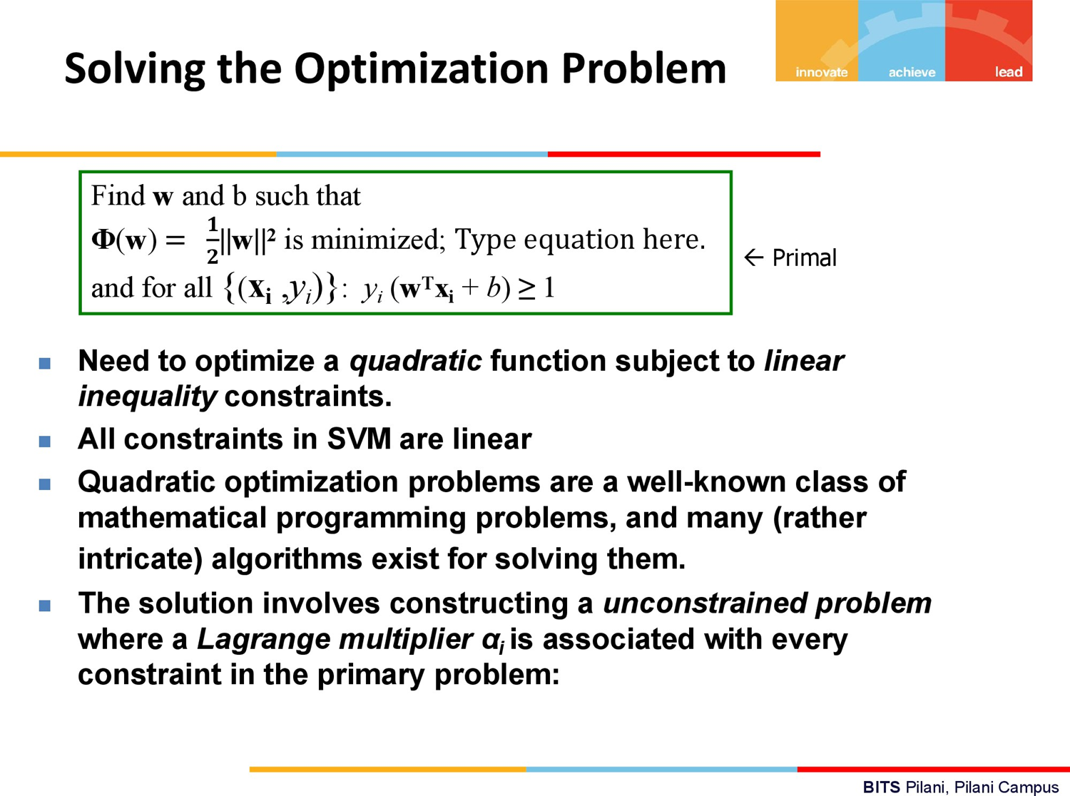

Slide 38
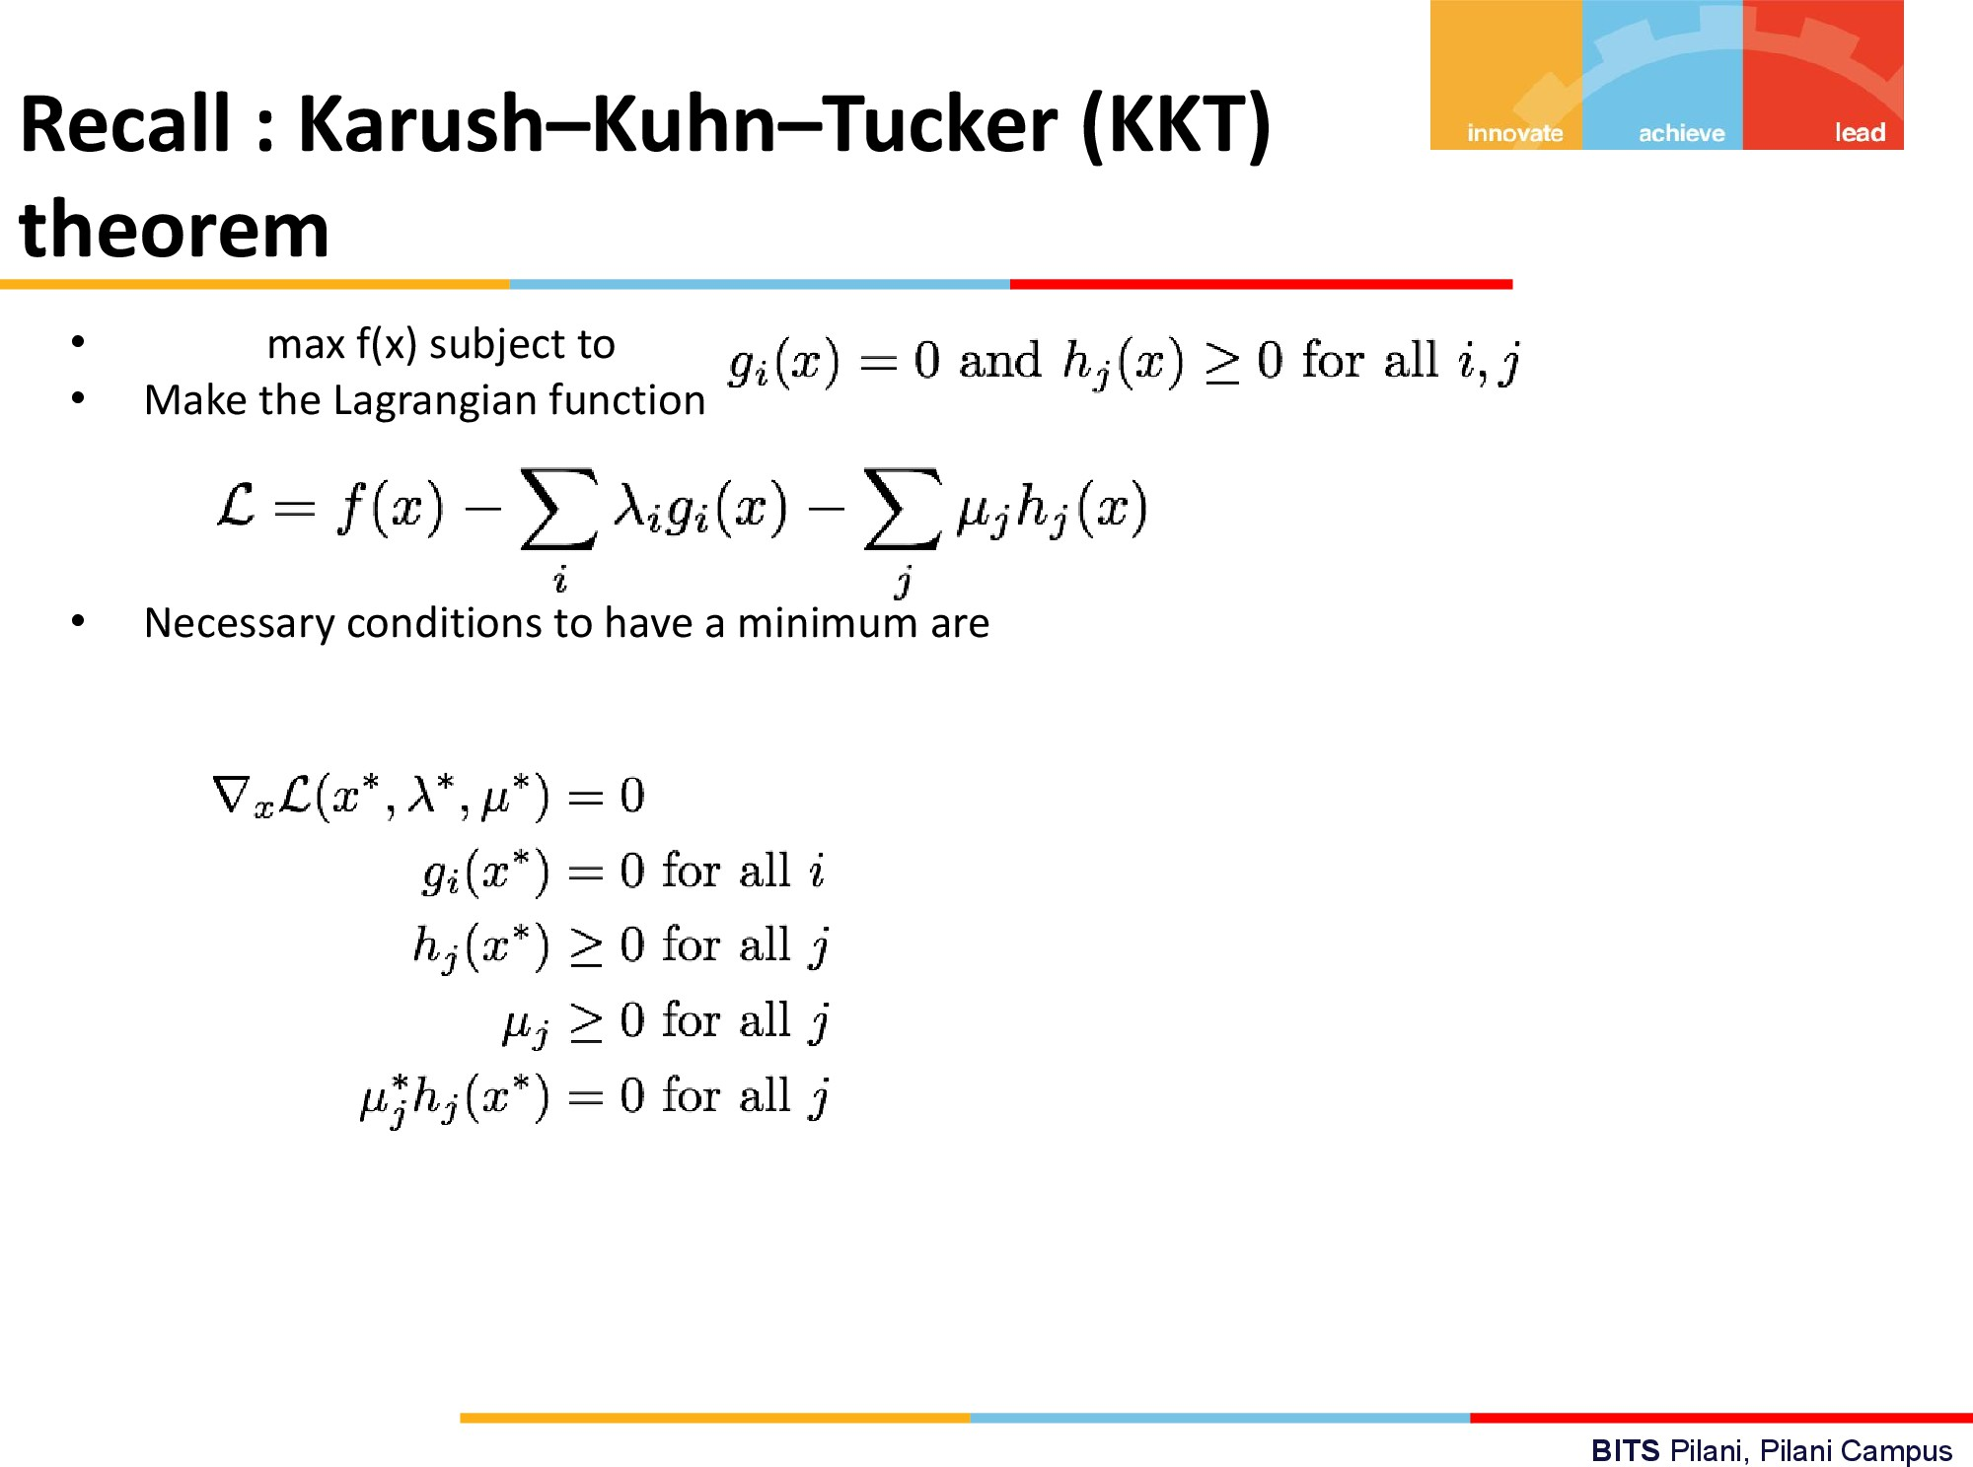

Slide 39
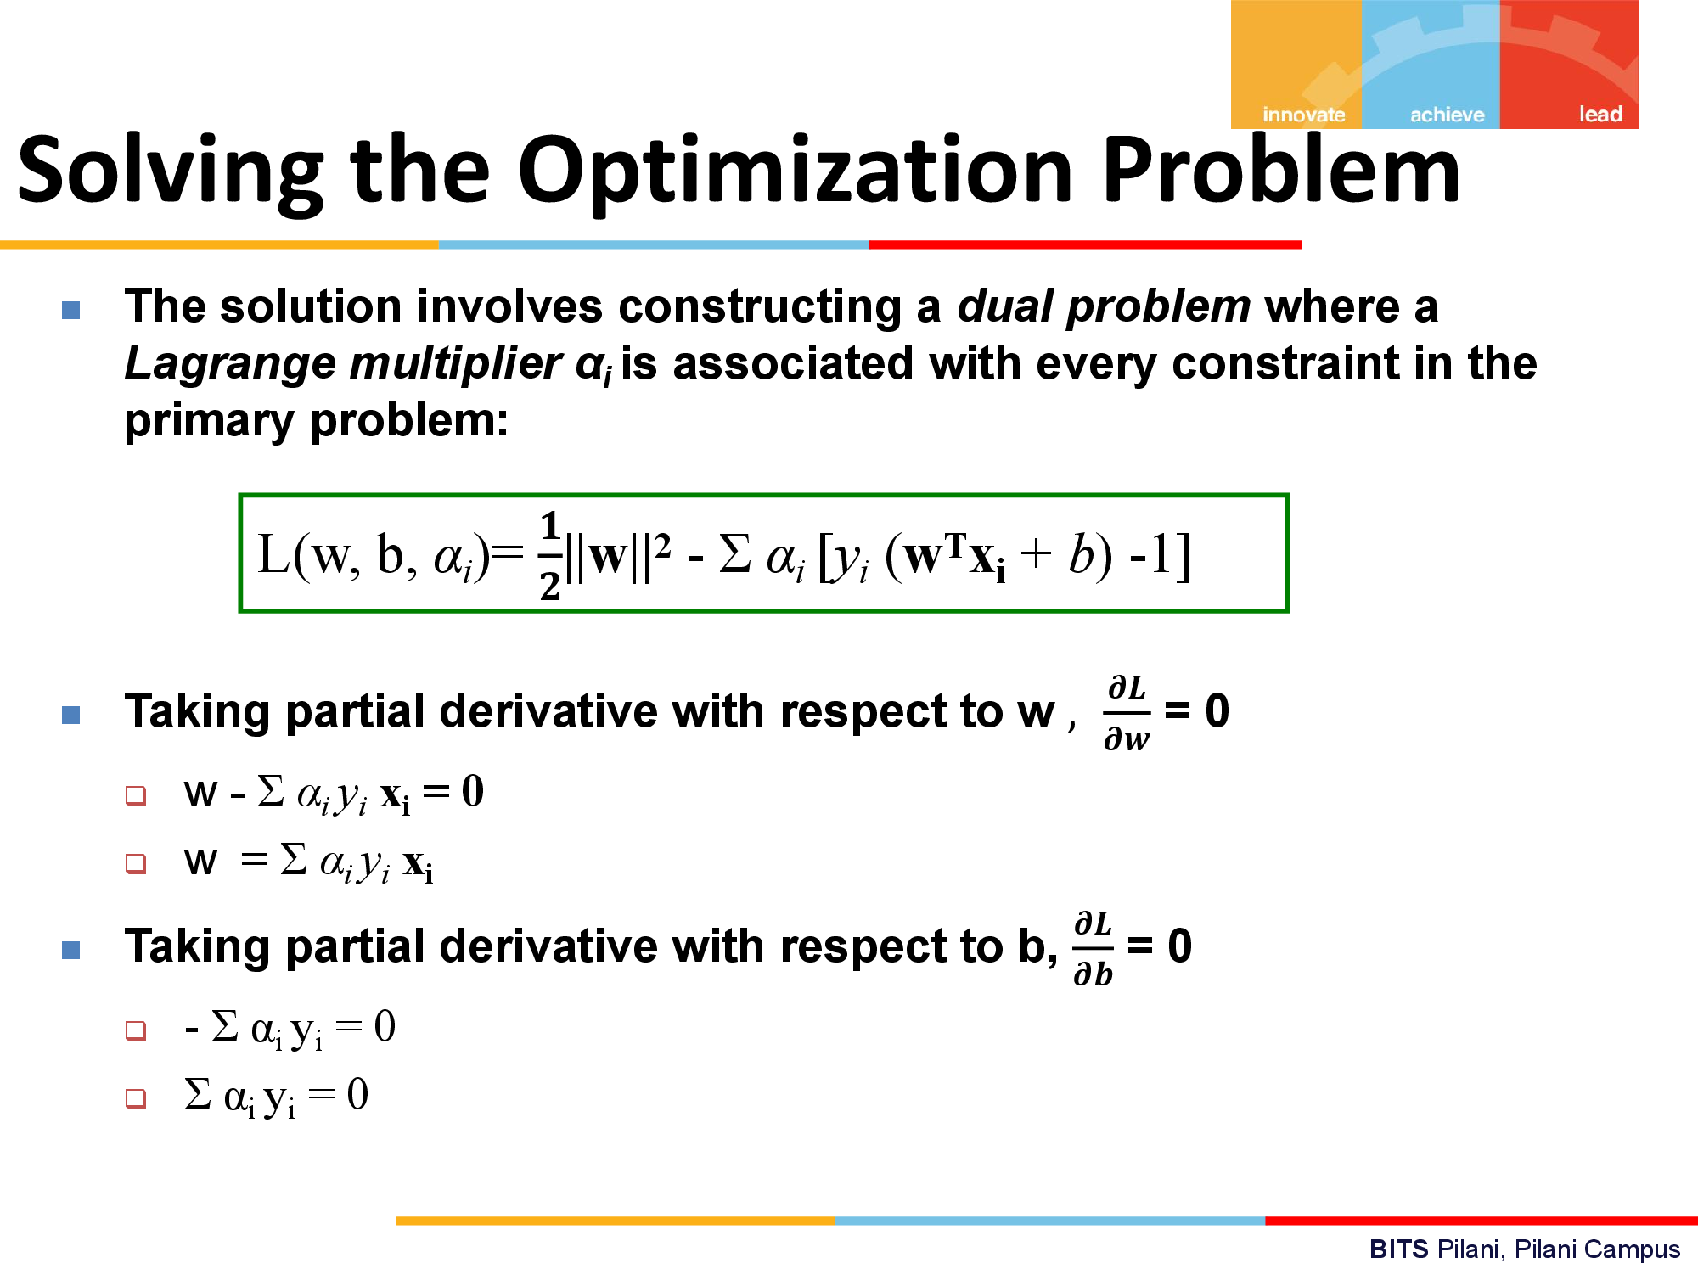

Slide 40
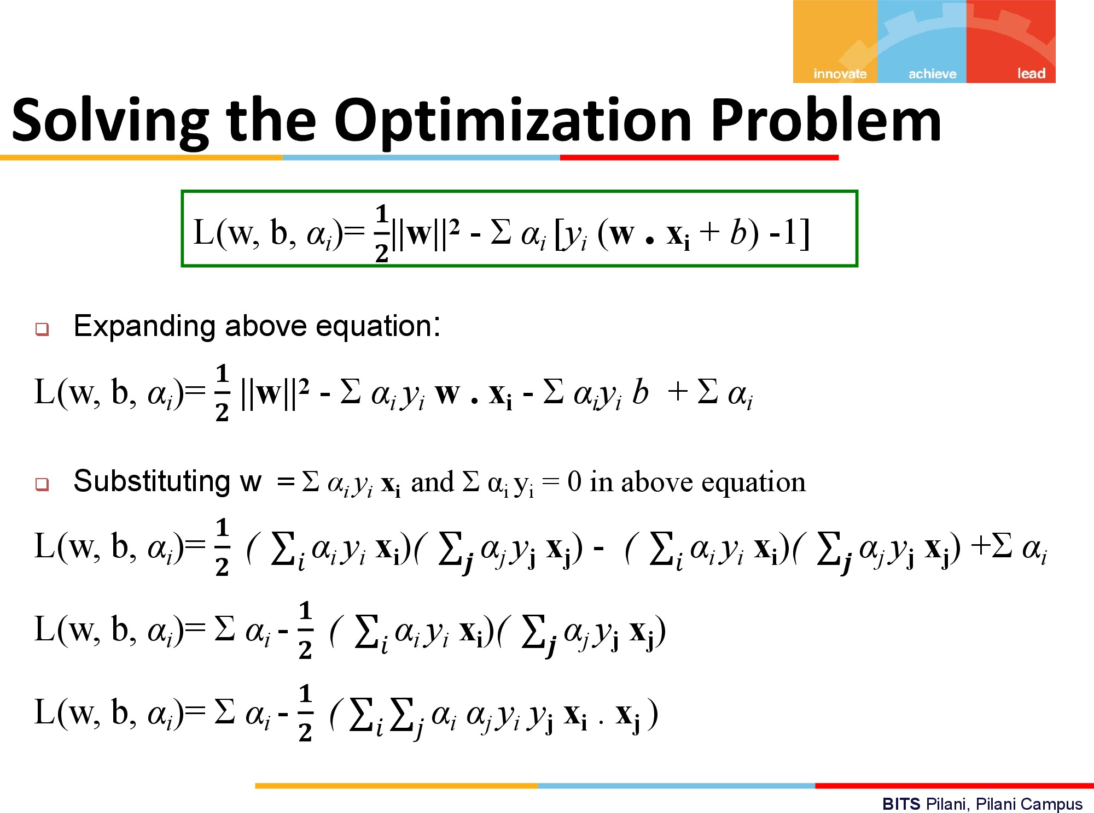

Slide 41
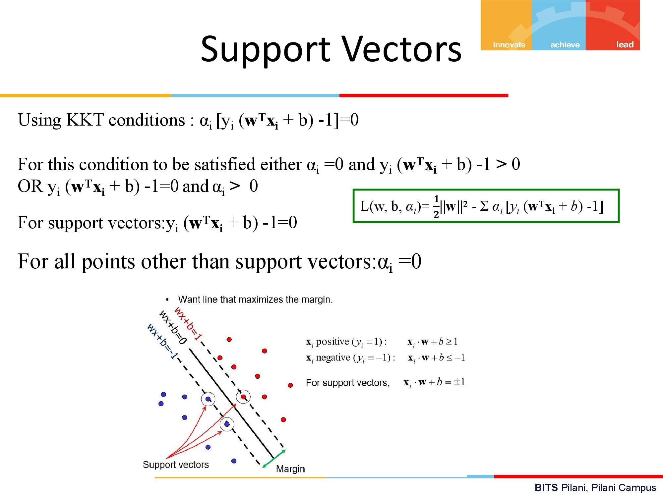

Slide 42
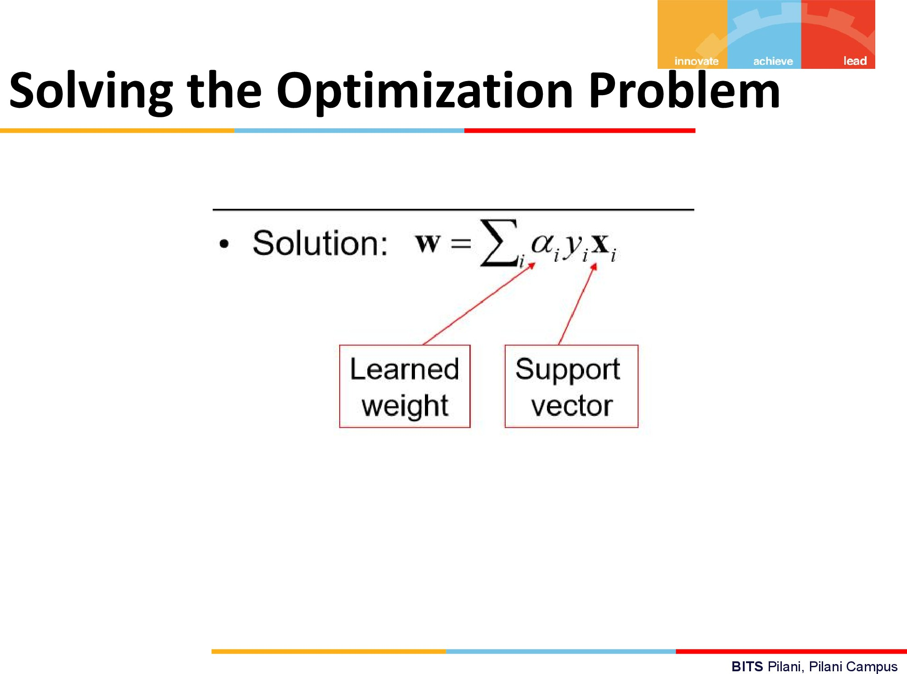

Slide 43
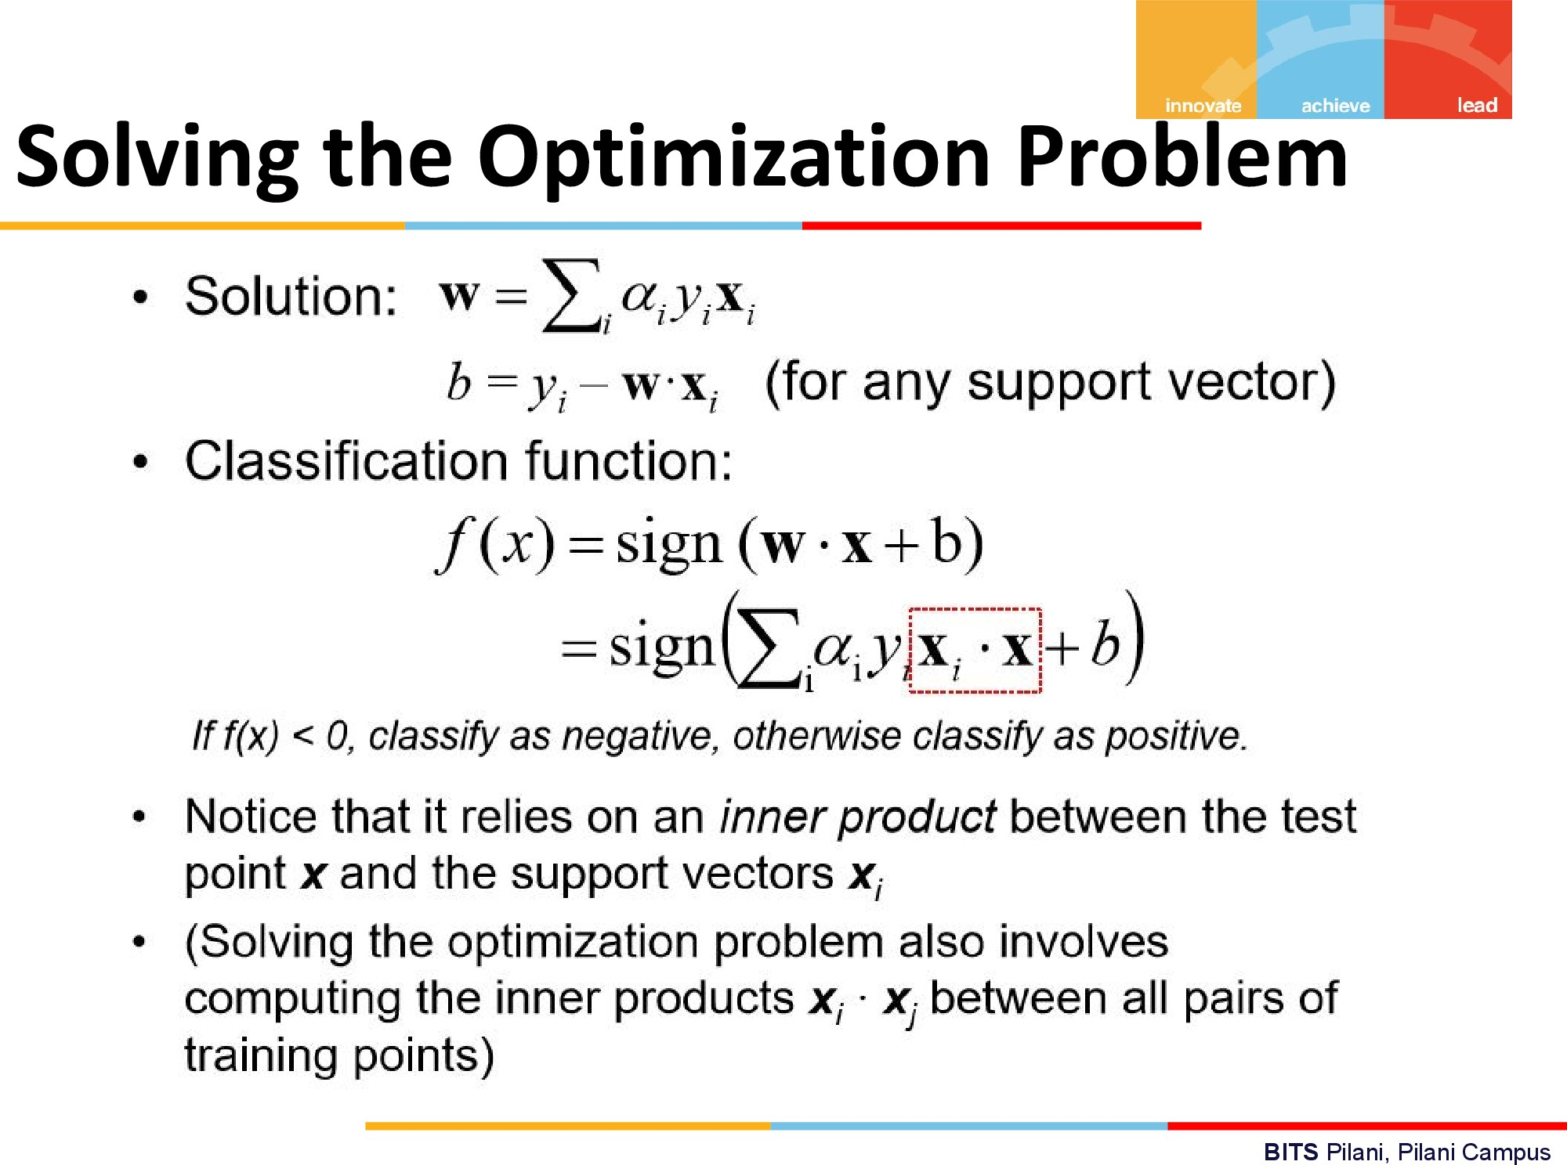

Slide 44
